Slide 1
Computational Complexity
CSC-114 Data Structure and Algorithms

Slide 2
outline
Analysis of Algorithms
Time complexity
Experimental Analysis
Big-O Analysis
Space complexity

Slide 3
Algorithm Analysis
How one algorithm is more efficient than other to perform same task?
Like binary search is more efficient than linear search
Efficiency is all about using resources efficiently and two key resources for a program are:
Running Time:
How much time it takes to complete
Space:
How much space it occupies while running
So algorithm analysis is about analyzing:
Time complexity
Space complexity

Slide 4
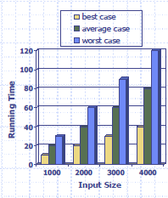
Time Complexity
Most algorithms transform input into output. The running time of an algorithm typically grows with the input size. There can be three different scenarios:
Worst case
Maximum number of time an algorithm takes on any input of size n.
Best case
Minimum number of time an algorithm takes on any input of size n.
Average case
Average number of time an algorithm takes on any input of size n.

Slide 5
Time Complexity
Worst-case analysis is much easier than average-case analysis, as it requires only the ability to identify the worst-case input, which is often simple
So, analysis focus on the worst case running time.
Easier to analyze
Crucial to applications such as games, finance and robotics.
what would happen if an autopilot algorithm ran drastically
slower for some unforeseen, untested inputs
How to measure running time?
Experimental Approach
Measure execution time by implementation and execution
Growth Rate Or Big-O analysis
Measure number of steps or statements and determine their growth rate

Slide 6
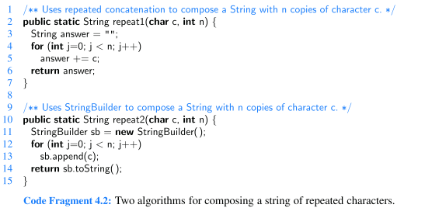
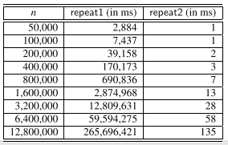
Experimental Approach
Implement the algorithm
Run it on a machine with different input sizes
Measure the actual running times and plot the results

Slide 7
Experimental Approach
Problems:
An algorithm must be fully implemented to study its running time
Results will vary depending upon hardware of machine, CPU, Memory
Even same system can take different time for same input, as CPU is shared with other processes.
Running times of two algorithms are difﬁcult to directly compare unless the experiments are performed in the same hardware and software environments.
One program may be better implemented than the other
Experiments can be done only on a limited set of test inputs; hence, they leave out the running times of inputs not included in the experiment (and these inputs may be important).
A Better Approach?
Count the steps/statements rather than time

Slide 8
Number of Steps/Statements
Number of statements executed by an algorithm can be defined as a function T of n. where n is input size. T(n) is called time complexity function.
For following algorithm
sum= 0
For i = 1 to n
sum+= i
End For
print sum
T(n)=3n+4
It means this algorithm will take 3n+4 steps/statements for given value of n.
Look for elementary operations like:
Variable assignment
Math (+, -, *, /, %)
Comparisons ( ==, >, <=, ...)
Calling a method
Returning from a method
Array allocation
Creating a new object

Slide 9
Example:2
sum=0
For i=1 to n step 1
For j=1 to k step 1
sum=sum+1
End For
End For
Print sum
T(n,k)= 3nk+4n+4
1 step
There can be more then one parameters as input. In this case T is defined as function of all those parameters.
Remember n is input size, it can be anything like V if we talk about trees, V and E if we talk about graphs
i=1→1
i< n→ n+1
Step 1 increment→ n
j=1→n
j< k→ n*(k+1)
Step 1 increment→ n*k
1 step (n*k time)
1 step

Slide 10
Number of Steps/Statements
Advantages:
Is performed by studying a high-level description of the algorithm without need for implementation.
Allows us to evaluate the relative efﬁciency of any two algorithms in a way that is independent of the hardware and software environment.
Takes into account all possible inputs from best case to worst case.
Disadvantages:
Two different algorithm’s time cannot be directly compared
Solution?
Focus on growth rate /order of T(n), rather than it’s actual value

Slide 11
Growth Order?
T(n)=3n+4 T(n)=5n T(n)=n²+100
Which one is efficient?
If growth order of one algorithm is slower than other algorithm for very larger n, we say that algorithm with slower growth order is more efficient than algorithm with faster growth order.
This process of approximating growth order of T(n) is called ASYMPTOTIC COMPLEXITY or ASYMPTOTIC BEHAVIOR of algorithm.

Slide 12
Growth Order?
How much faster T(n) will grow for larger values of n?
As n grows large
Terms with n changes more than terms which are constant
constants can be ignored for larger values of n as their contribution to T remains same
Terms with largest order of n becomes dominant than terms with lower order of n
It means lower order terms can be neglected for larger values of n to find growth order, because their contribution to T grows at slower rate with compare to terms with higher order as n grows
Coefficients can also be neglected
They become irrelevant when comparing two functions with different order
n | T(n)=5n²⁺2n+5 | T(n)=3n+3
100 | 5*10,000+2*100+5 | 3*100+4
1,000 | 5*10,00,000+2*1,000+5 | 3*1,000+4
10,000 | 5*10,000,000,000+2*10,000+5 | 3*10,000+4

Slide 13
Asymptotic Analysis
Asymptotic analysis is very useful for comparing algorithm efficiency. It defines the growth order of algorithm rather than exact number of steps.
As steps are not universally defined, so T(n) is not very accurate approach to measure time complexity. Moreover, every machine can take different time for given steps.
So Asymptotic analysis categorize the algorithms on basis of their growth order
T(n)= 3n+4→O(n) T(n)=n²+5n+100→O(n²) T(n)= 7n+1000→O(n)
Algorithm with complexity Order n² is slower than algorithm with Order n
O stands for Order, and is referred as Big-O

Slide 14
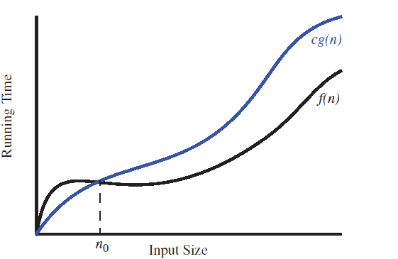
What is Big-O?
Let f (n) and g(n) are two functions mapping nonnegative integers to real numbers. We say that f (n) is O(g(n)) if there exist a real constant c > 0 and an integer constant n₀ ≥ 1 such that:
f (n) ≤ c* g(n), for all n ≥ n₀.
Example: T(n)= 8n-2➔O(n)
How?
we need to find a real constant c>0 and
an integer constant n₀≥ 1 such that
8n+2 ≤ cn for every integer n ≥ n₀.
c=10
n₀=1
g(n) is called the upper bound or Order of f(n)
Upper bound means f(n) will not grow faster than g(n) for given c and n₀

Slide 15
Big-O
Example: T(n) = n² + 3n + 4➔O(n²⁾
c=8
n₀=1
Example: T(n)=3log(n)+2 ➔O(log(n)).
c=5
n₀=2
Note that log(n) is zero for n = 1. That is why we use n₀ = 2.

Slide 16
Big-O Rules
If f(n) is a polynomial of degree d, then f(n) is O(n^{d}).
Drop lower-order terms
Drop constant factors
Example: T(n)=5n²+n➔O(n²)
If f(n)=c where c is any constant, then f(n) is O(1)
Use the smallest possible class of functions
Say “2n +3 is O(n)” instead of “O(n²)”
5n²+n is O(n²) rather than O(n) or O(n³)

Slide 17

Major Growth Orders
The big-O notation gives an upper bound on the growth rate of a function
The statement “f(n) is O(g(n))” means that the growth rate of f(n) is no more than the growth rate of g(n). O(n²) is O(n) but O(n) is not O(n²).
We can use the big-O notation to rank functions according to their growth rate.
Seven functions are ordered by increasing growth rate in the sequence below, that is, if a function f (n) precedes a function g(n) in the sequence, then f(n) is O(g(n)):

Slide 18
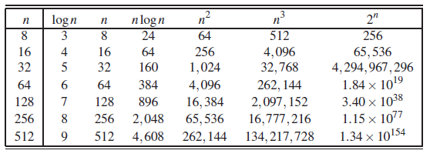
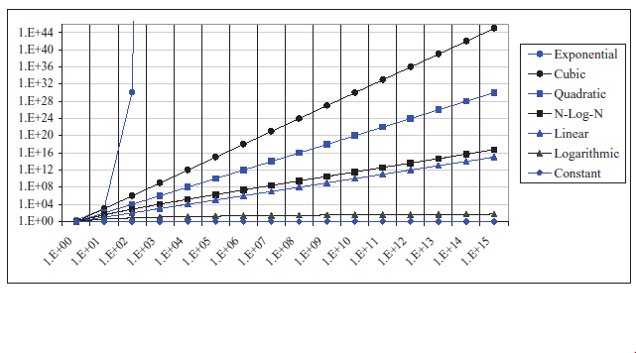
Growth Rate Comparison
Growth rate comparison:
Difference is more visible
at larger values of n

Slide 19
Constant
If input size does not affect the algorithm time
int a, b, max;
input a
input b
If(a>=b)
max=b;
else
max=a;
print max
for i=1 to 10 step 1
print n
INSERT(head,node)
node.next=head
head=node

Slide 20
Linear
When algorithm time is directly proportional to input size
Single loops
sum=0
for (i=0;i<n;++i)
sum++;
print sum
for i=0 ; i< n-5; i++)
print i*n
for (i=1;i<n/2; i+=1)
print i*n

Slide 21
Logrithmic
When algorithm time is proportional to logarithm of input size
Where loop counter increased with multiplication factor
for (i=1;i<=n; i*=2)
print i
for (i=1;i<=n; i*=3)
print i

Slide 22
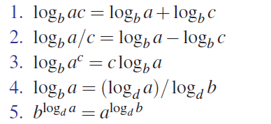
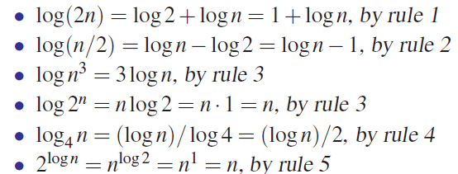
Logarithm Rules
Given real numbers a > 0, b > 1, c > 0 and d > 1, we have:

Slide 23
Linearithmic/nlogn
Combination of linear and logarithmic
for (i=1;i<=n; i++)
for(i=1;i<=n; i*=2)
print i

Slide 24
Quadratic
When algorithm time is directly proportional to square of input size.
Nested loops
sum=0
for (i=0;i<n;++i)
for (j=0;j<n;++j)
sum++
print sum
T(n)= 3n²+4n+4
for (i=1;i<n; i++)
for (j=1;j<i; j++)
print i

Slide 25
Cubic
When algorithm time is directly proportional to cube of input size
Triple nested loops
sum=0
for (i=0;i<n;++i)
for (j=0;j<n;++j)
sum++
print sum
T(n)= 3n²+4n+4

Slide 26
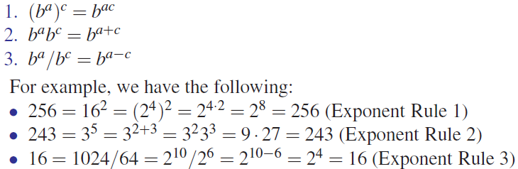
Exponential
Involves dynamic programming and brute force algorithms
Few recursion problems also run in exponential time.
Exponential Rules: Given positive integers a, b, and c, we have:

Slide 27
Space Complexity
The number of memory cells which an algorithm needs to complete itself. We will again focus on worst case and Big-Oh terms.
Example1 O(1)
sum(x, y, z)
{
set r = x + y + z
return r
}
Example2 O(n)
sum(a[], n) {
r = 0;
for (i = 0; i < n; ++i) {
r += a[i]
}
return r
}

Slide 28
Summary
In this lecture, we have discussed:
Complexities of algorithms in terms of time and space
Time complexity function T(n)
Asymptotic analysis and Big-O
Book Chapter→3

